Slide 1

BC3 SYMPOSIUM
12-13 NOVEMBER 2023
Analyzing the trade-offs of sustainable diets on the long-term SDG goals
Clàudia Rodés Bachs (BC3), Jon Sampedro,
Dirk-Jan Van de Ven, Russell Horowitz,
Xin Zhao and Guillermo Pardo
www.iam-compact.eu

Slide 2
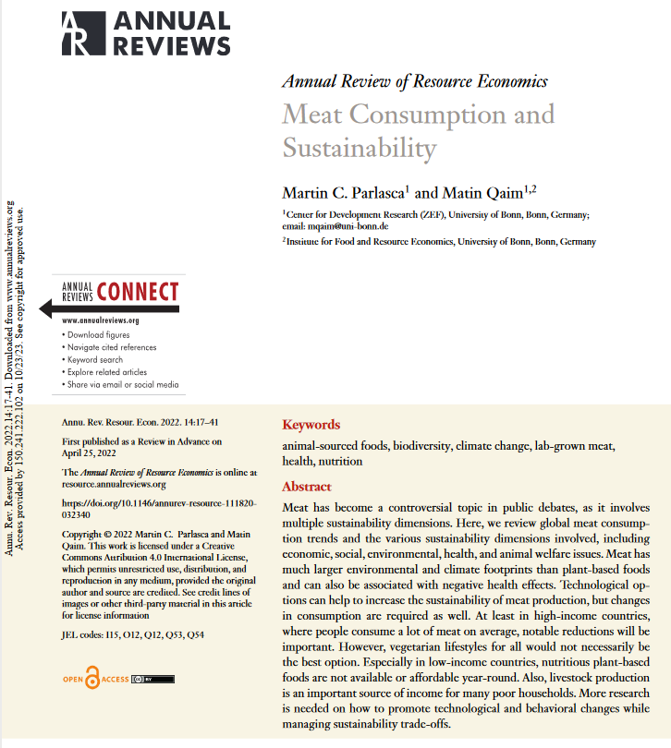
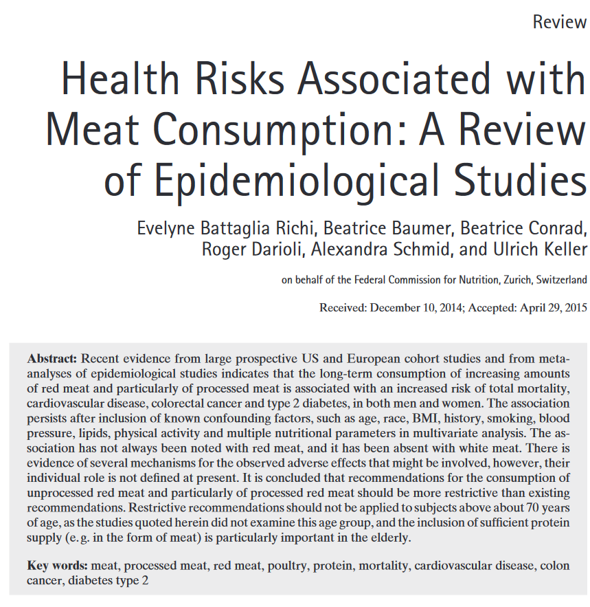
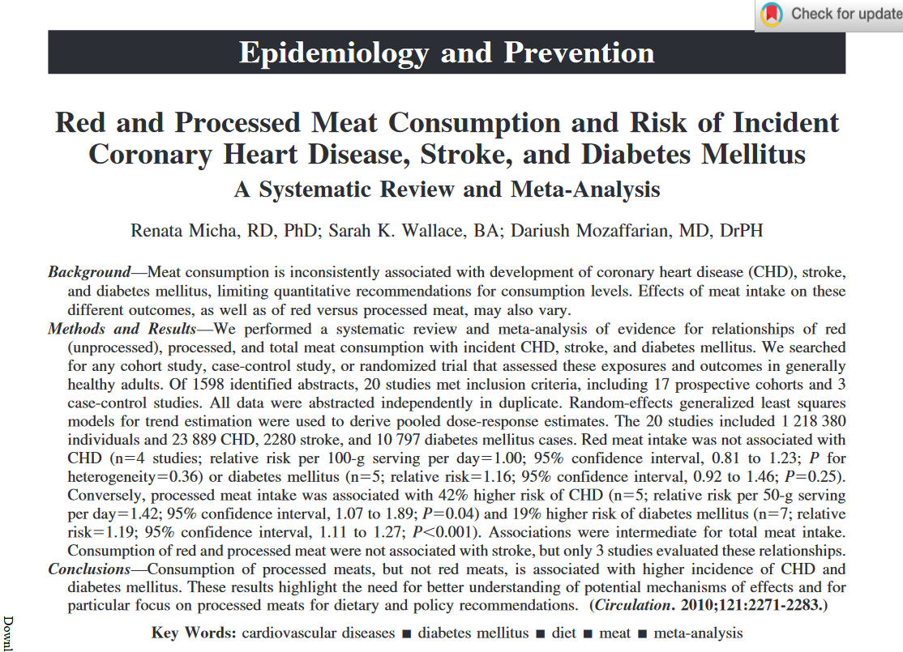
Motivation

Slide 3
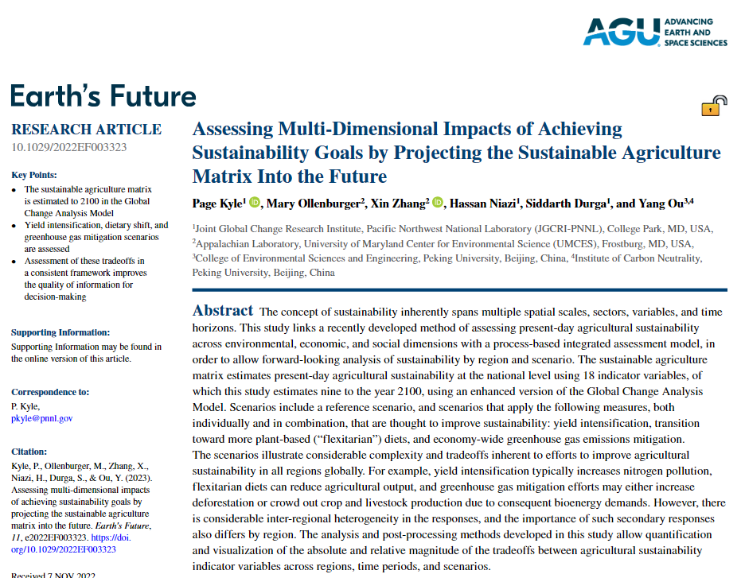
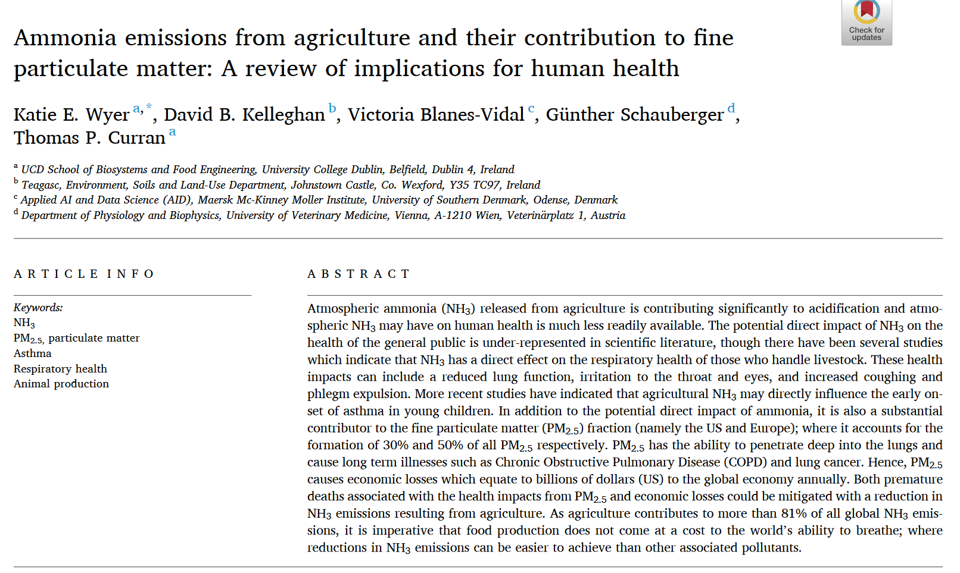
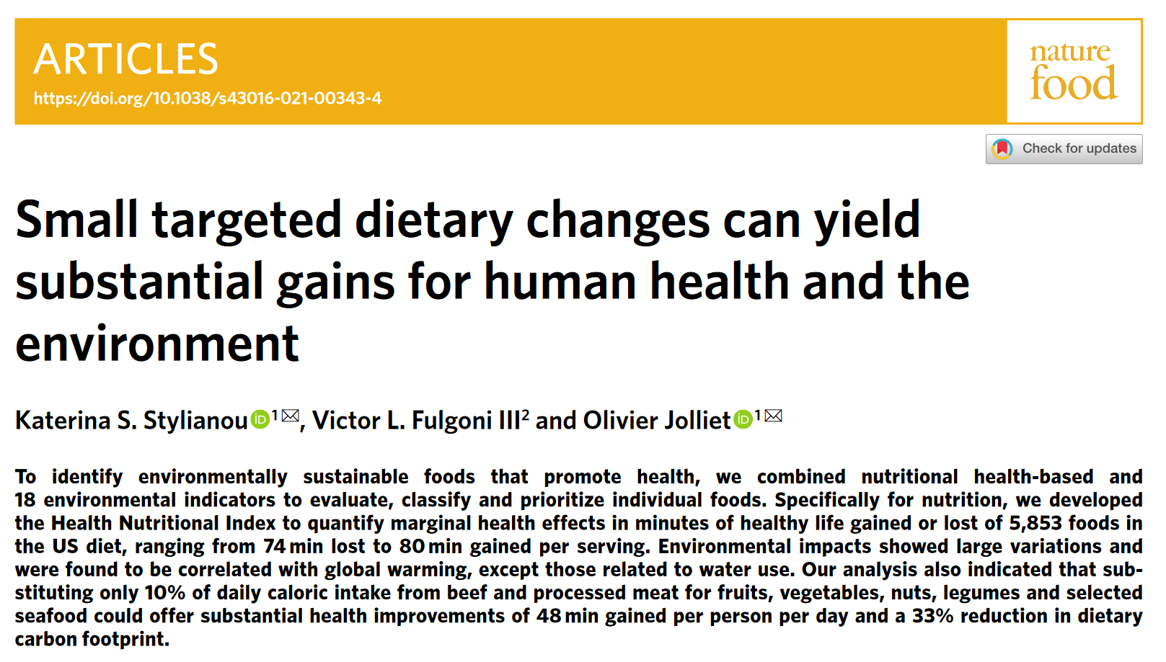
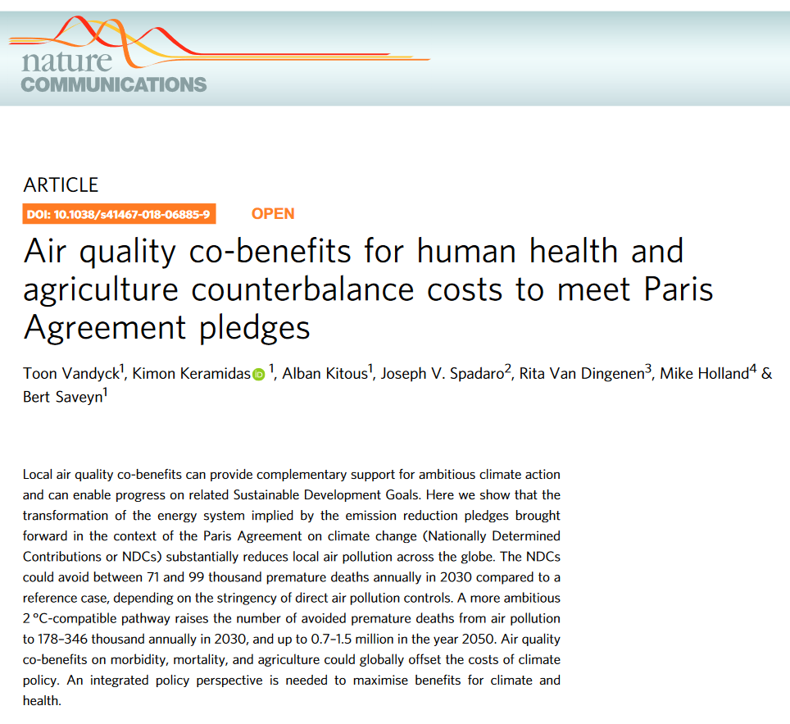
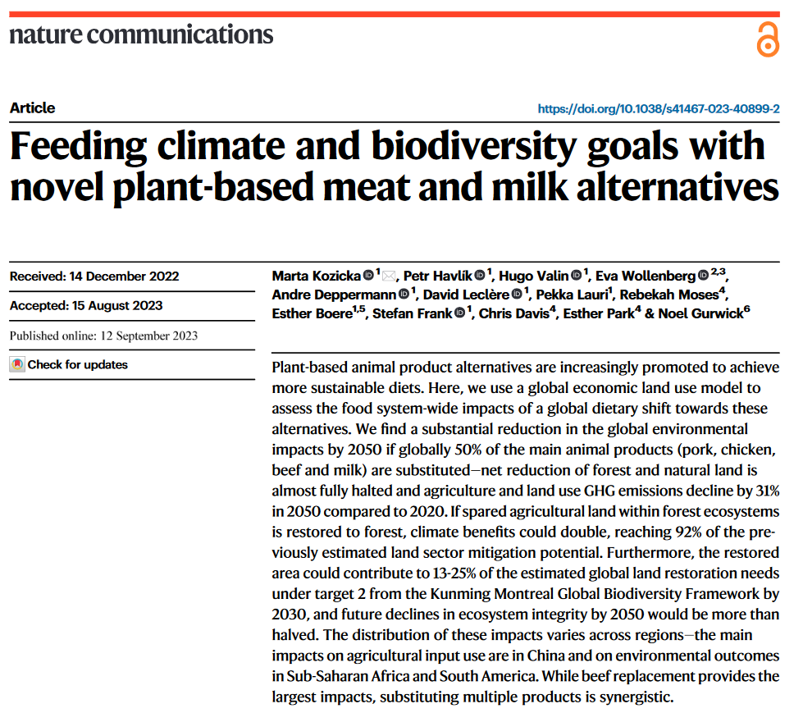
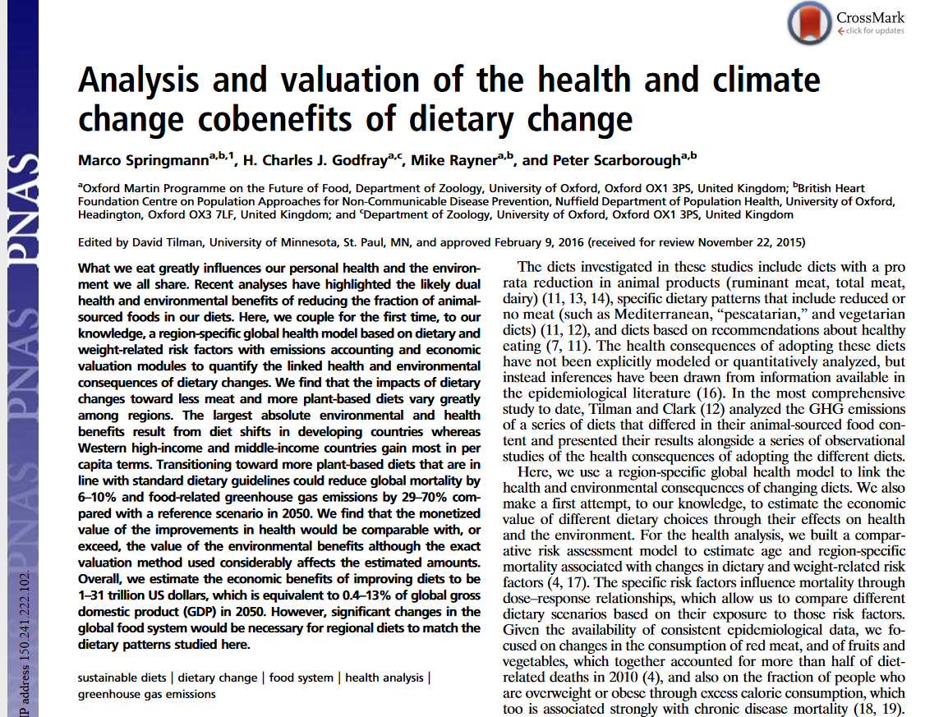
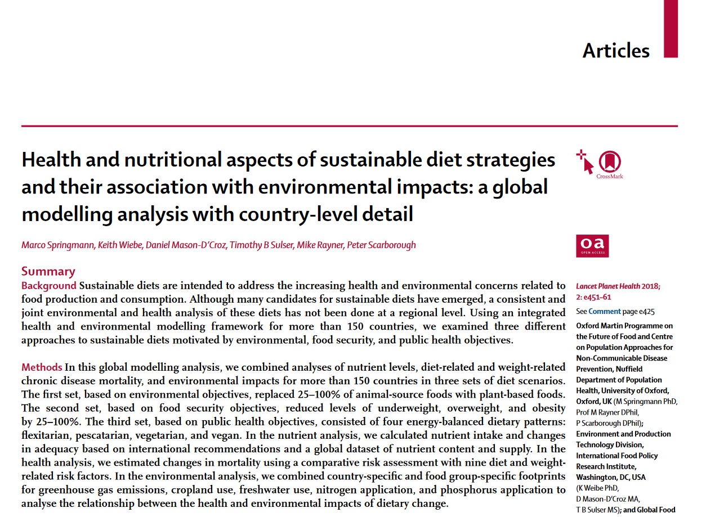
Motivation

Slide 4
Our goals
Q1. | Which will be the system-wide benefits of plant protein based diets?
Q2. | Which will be the system-wide benefits of no rumiants protein based diets?

Slide 5
Our goals
Q1. | Which will be the system-wide benefits of plant protein based diets?
Q2. | Which will be the system-wide benefits of no rumiants protein based diets?

Slide 6
Our goals
Q1. | Which will be the system-wide benefits of plant protein based diets?
Q2. | Which will be the system-wide benefits of no rumiants protein based diets?
SDG1. | Poverty
 | - Daily food expenditure per capita

Slide 7
Our goals
Q1. | Which will be the system-wide benefits of plant protein based diets?
Q2. | Which will be the system-wide benefits of no rumiants protein based diets?
SDG1. | Poverty
SDG2. | Alimentation
 | - Macronutrients consumption
 | - Micronutreitns consumption
 | - Kcal per capita consumption

Slide 8
Our goals
Q1. | Which will be the system-wide benefits of plant protein based diets?
Q2. | Which will be the system-wide benefits of no rumiants protein based diets?
SDG1. | Poverty
SDG2. | Alimentation
SDG3. | Health
 | - Premature deaths due to air pollution
 | - Nutritional health related issues

Slide 9
Our goals
Q1. | Which will be the system-wide benefits of plant protein based diets?
Q2. | Which will be the system-wide benefits of no rumiants protein based diets?
SDG1. | Poverty
SDG2. | Alimentation
SDG3. | Health
SDG6. | Water management
 | - Water consumption by crop and livestock
 | - Irrigated and Rainfed water demand

Slide 10
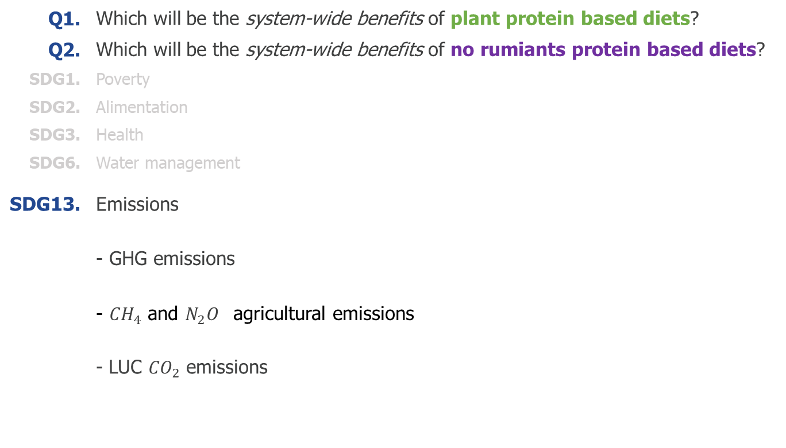
Our goals
Q1. | Which will be the system-wide benefits of plant protein based diets?
Q2. | Which will be the system-wide benefits of no rumiants protein based diets?
SDG1. | Poverty
SDG2. | Alimentation
SDG3. | Health
SDG6. | Water management
SDG13. | Emissions
 | - GHG emissions
 | - ${CH}_{4}$ and $N_{2}O^{}$agricultural emissions
 | - LUC ${CO}_{2}$ emissions

Slide 11
Our goals
Q1. | Which will be the system-wide benefits of plant protein based diets?
Q2. | Which will be the system-wide benefits of no rumiants protein based diets?
SDG1. | Poverty
SDG2. | Alimentation
SDG3. | Health
SDG6. | Water management
SDG13. | Emissions
SDG15. | Land Use
 | - Distribution of land use areas
 | - Re-forestation
 | - Fertilizer demand
 | - Crop loss due to air pollution
 | - Carbon stock

Slide 12










Scenarios
Animal protein
Plant
protein
Plant Protein based diets (SPP)
Icons from https://www.flaticon.com/
Notes:
<a href="https://www.flaticon.com/free-icons/cow" title="cow icons">Cow icons created by Flat Icons - Flaticon</a>

Slide 13









Scenarios
Rumiants’ protein
Animal protein
Fish
protein
Monogastrics’ protein
Plant
protein
Plant protein
Plant Protein based diets (SPP)
No Rumiants protein based diets
(SNR)
Icons from https://www.flaticon.com/
Notes:
<a href="https://www.flaticon.com/free-icons/cow" title="cow icons">Cow icons created by Flat Icons - Flaticon</a>

Slide 14

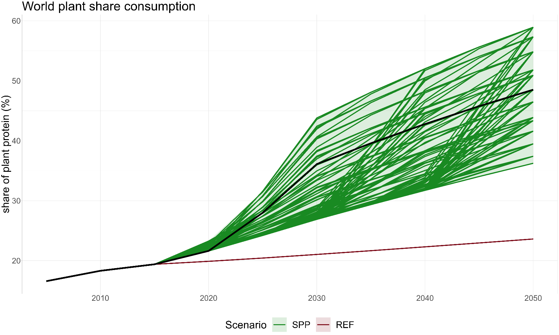

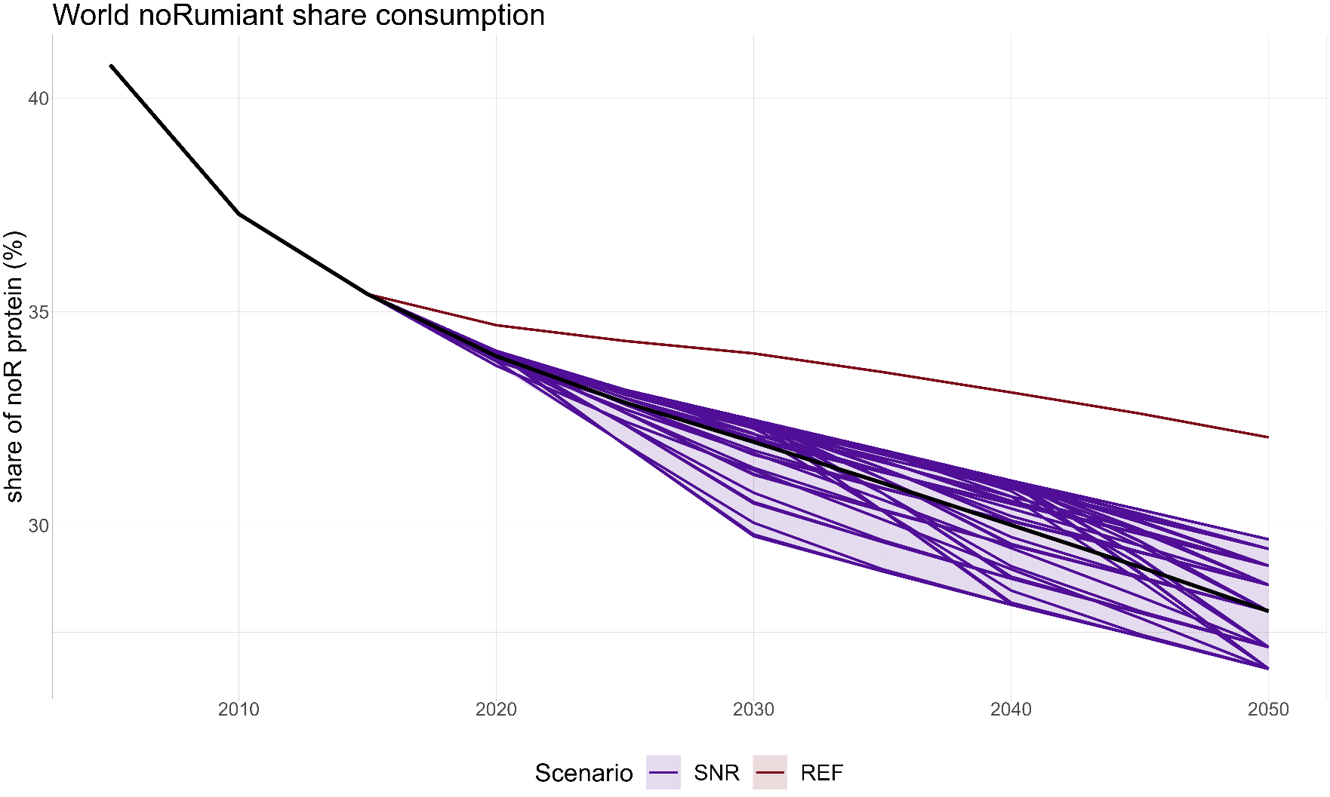
Scenarios
peak year
final share
Based on logistic curves
slope
Fig baseline + all runs
world

Slide 15
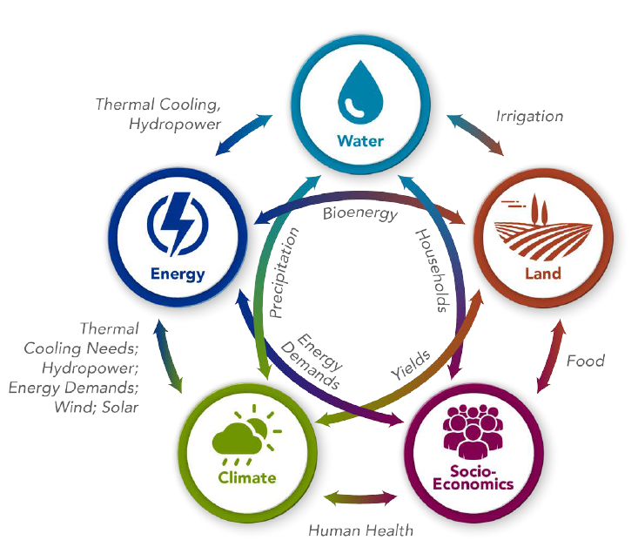
The model: GCAM
GCAM is a powerful Integrated Assessment Model
We used GCAM and linked with other tools to derive the results

Slide 16
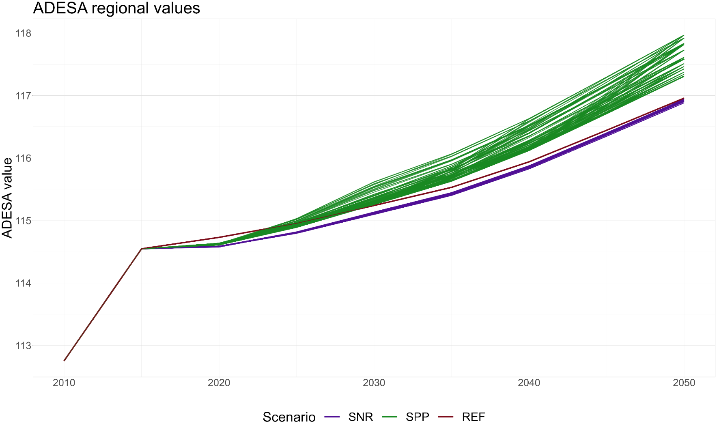
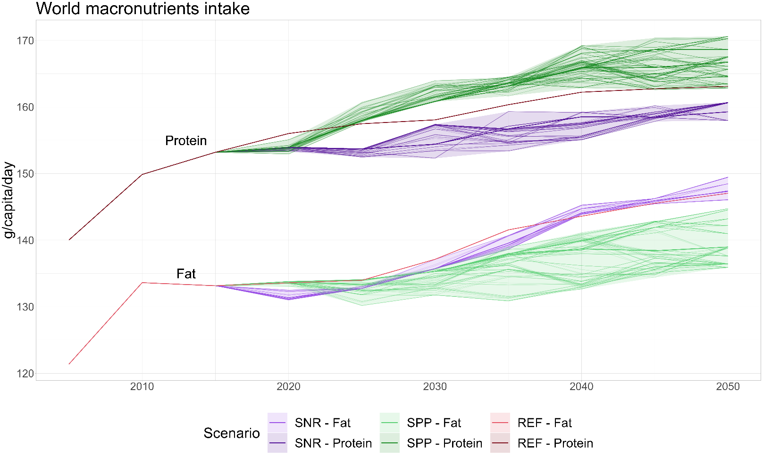
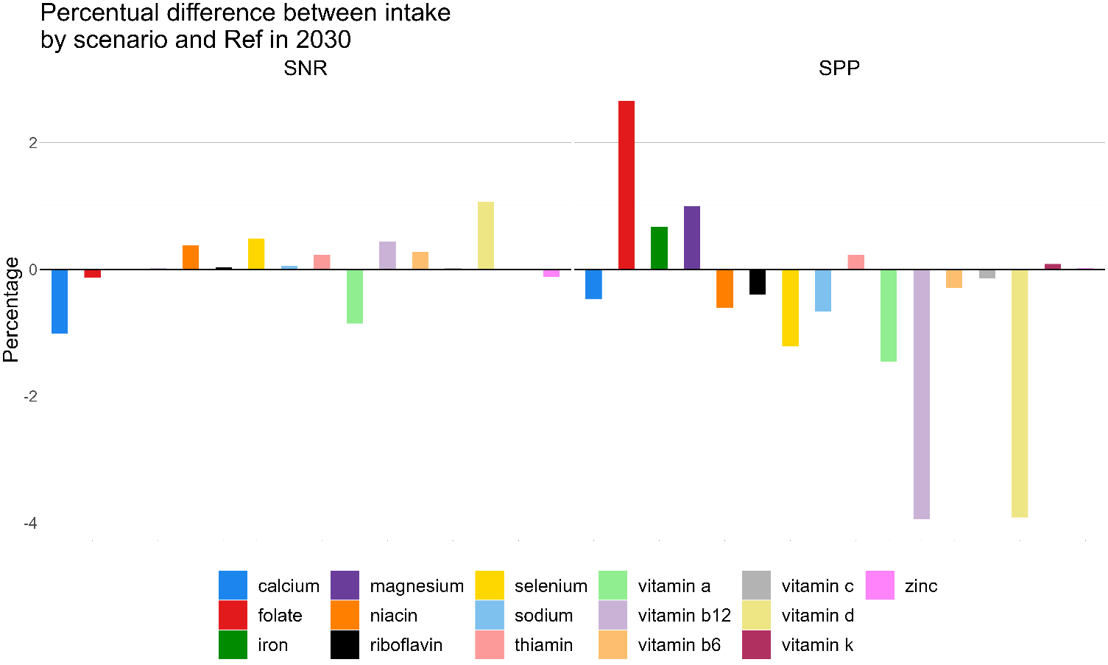
Nutritional point of view
Fig: Kcal intake
Notes:
Average Dietary Energy Supply Adequacy

Slide 17
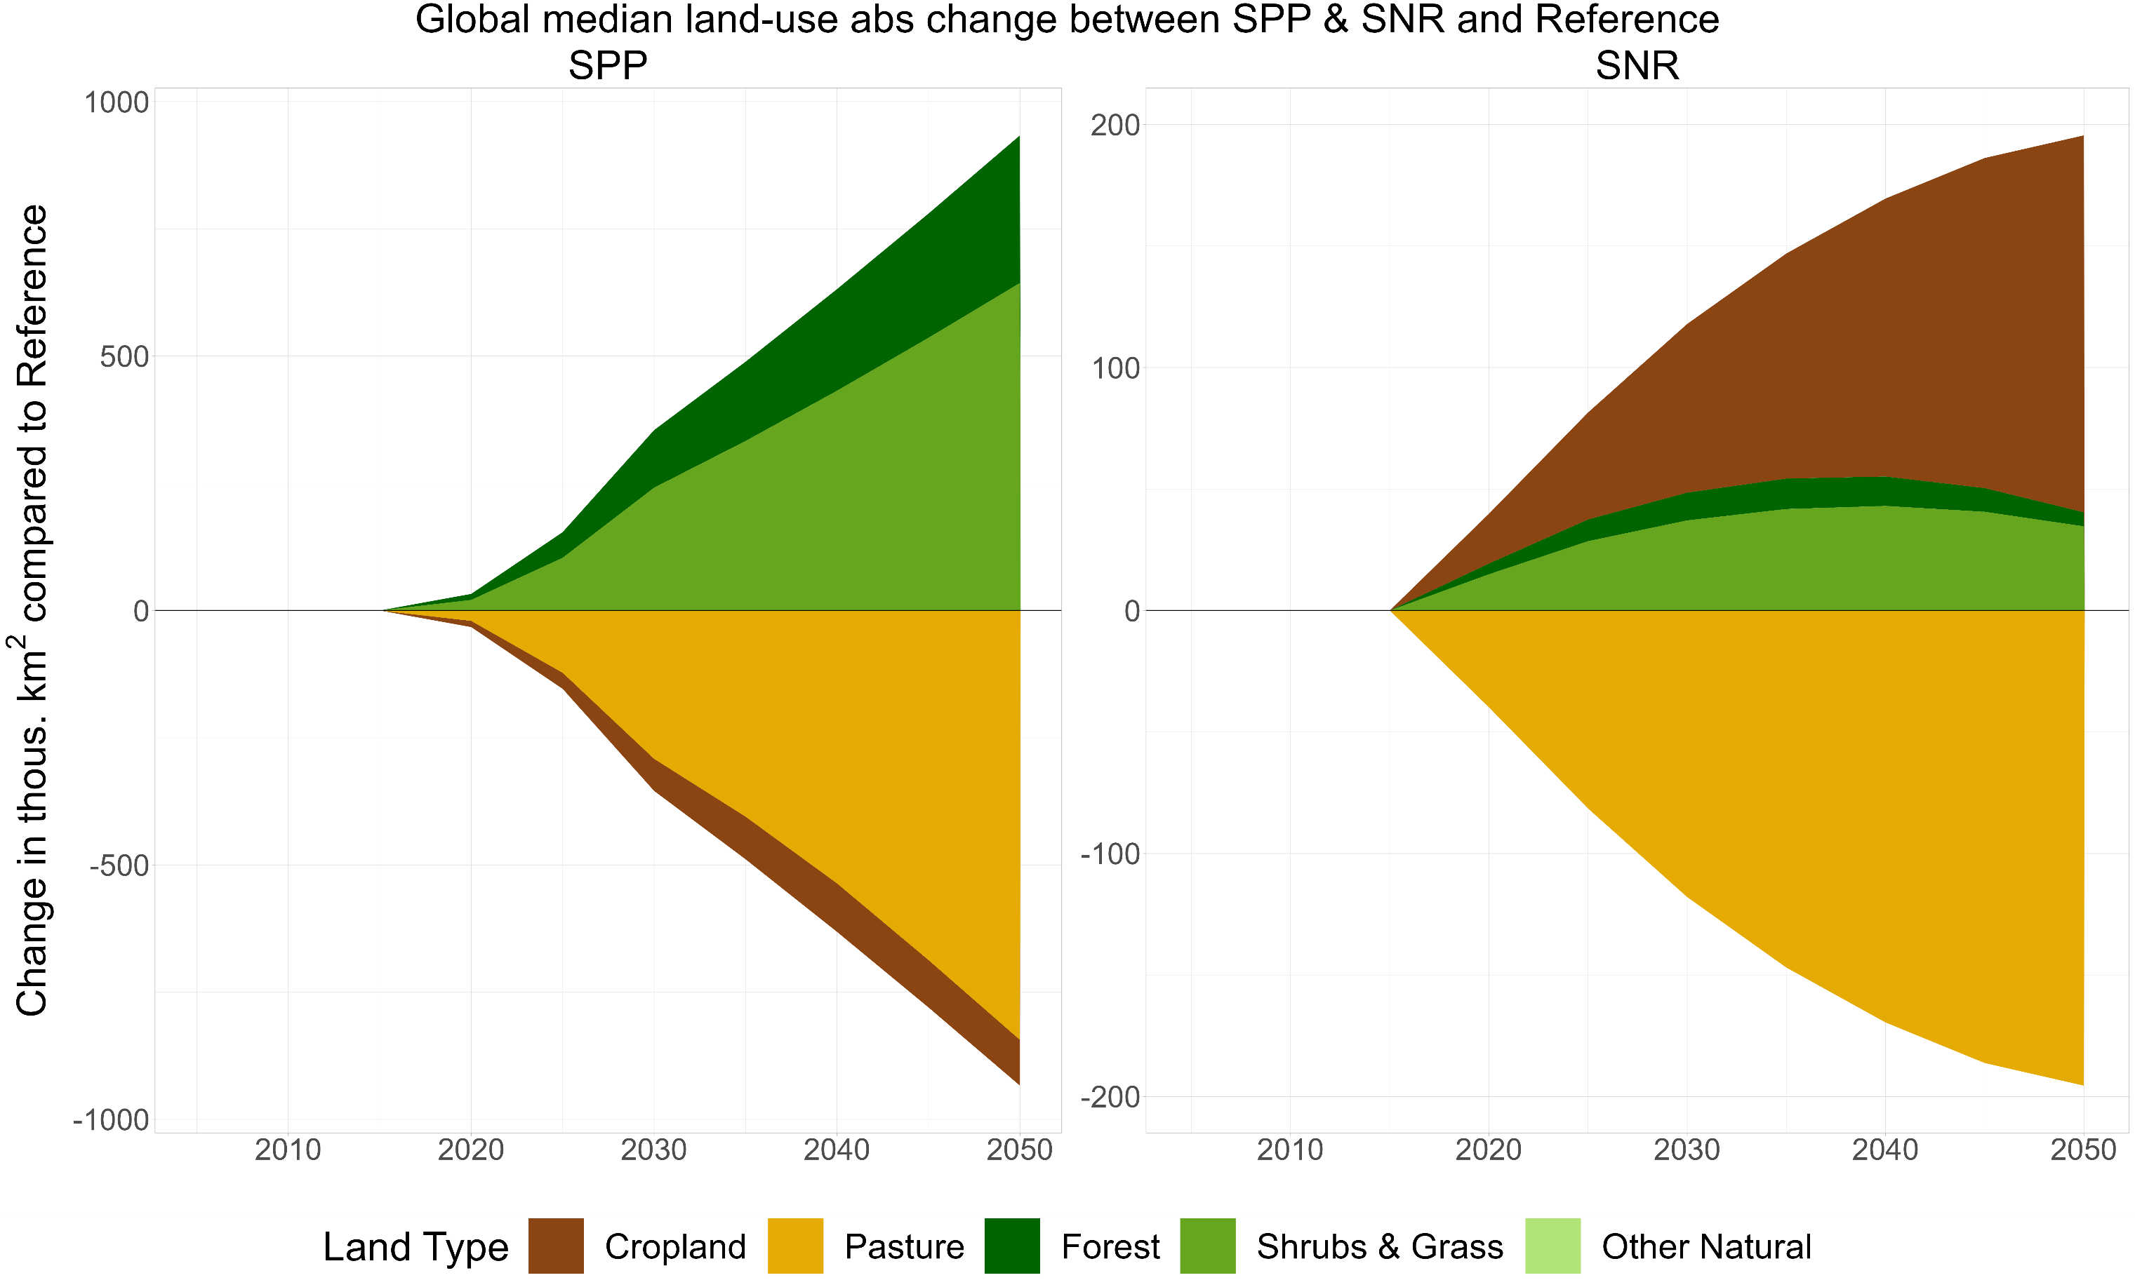
Land types
SPP reduces cropland for feed and pastures for animals
SNR reduces pasture but increases cropland due to feed purposes
Fig: land use world

Slide 18
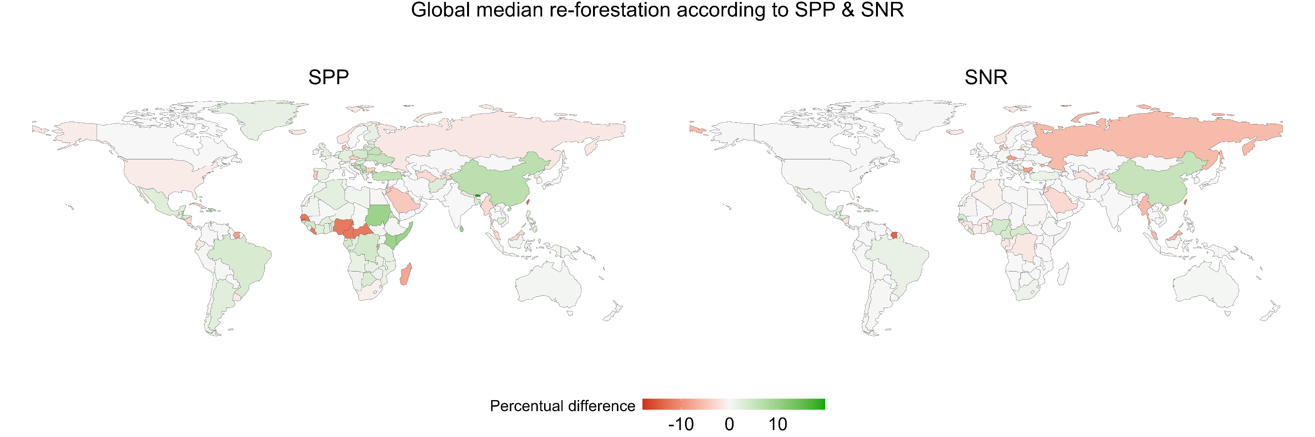
Re-forestation
Fig: re-forestation
Some regions would increase their burden when exporting Nuts and Legumes
Some regions would drastically reduce their animal protein production and would re-forest

Slide 19
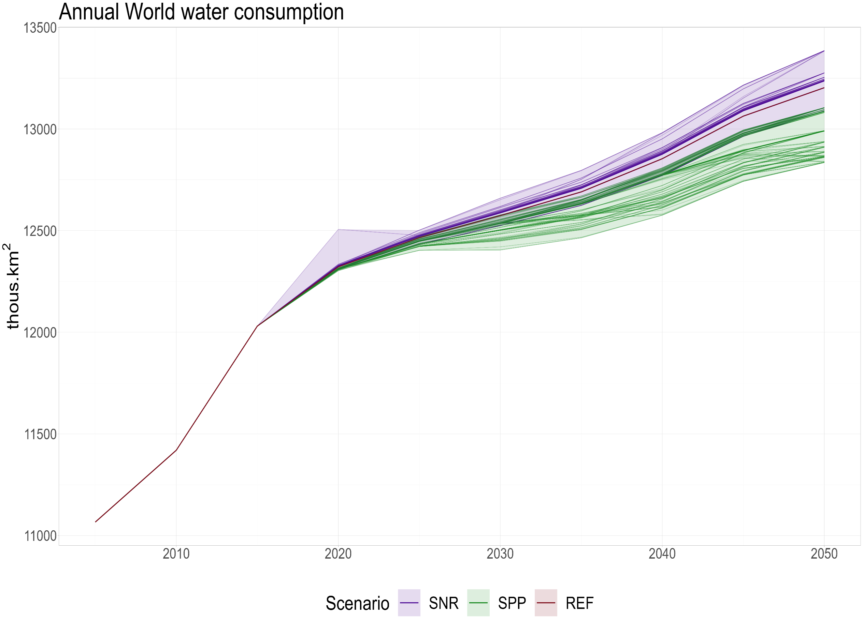
Water
SPP reduced cropland for feed, which is very water-intensive
SNR increased cropland for feed, which makes the water consumption increase
Fig: water consumption

Slide 20
Water
SPP reduced cropland for feed, which is very water-intensive
SNR increased cropland for feed, which makes the water consumption increase
Fig: water consumption

Slide 21
Water
SPP reduced cropland for feed, which is very water-intensive
SNR increased cropland for feed, which makes the water consumption increase
Fig: water consumption

Slide 22
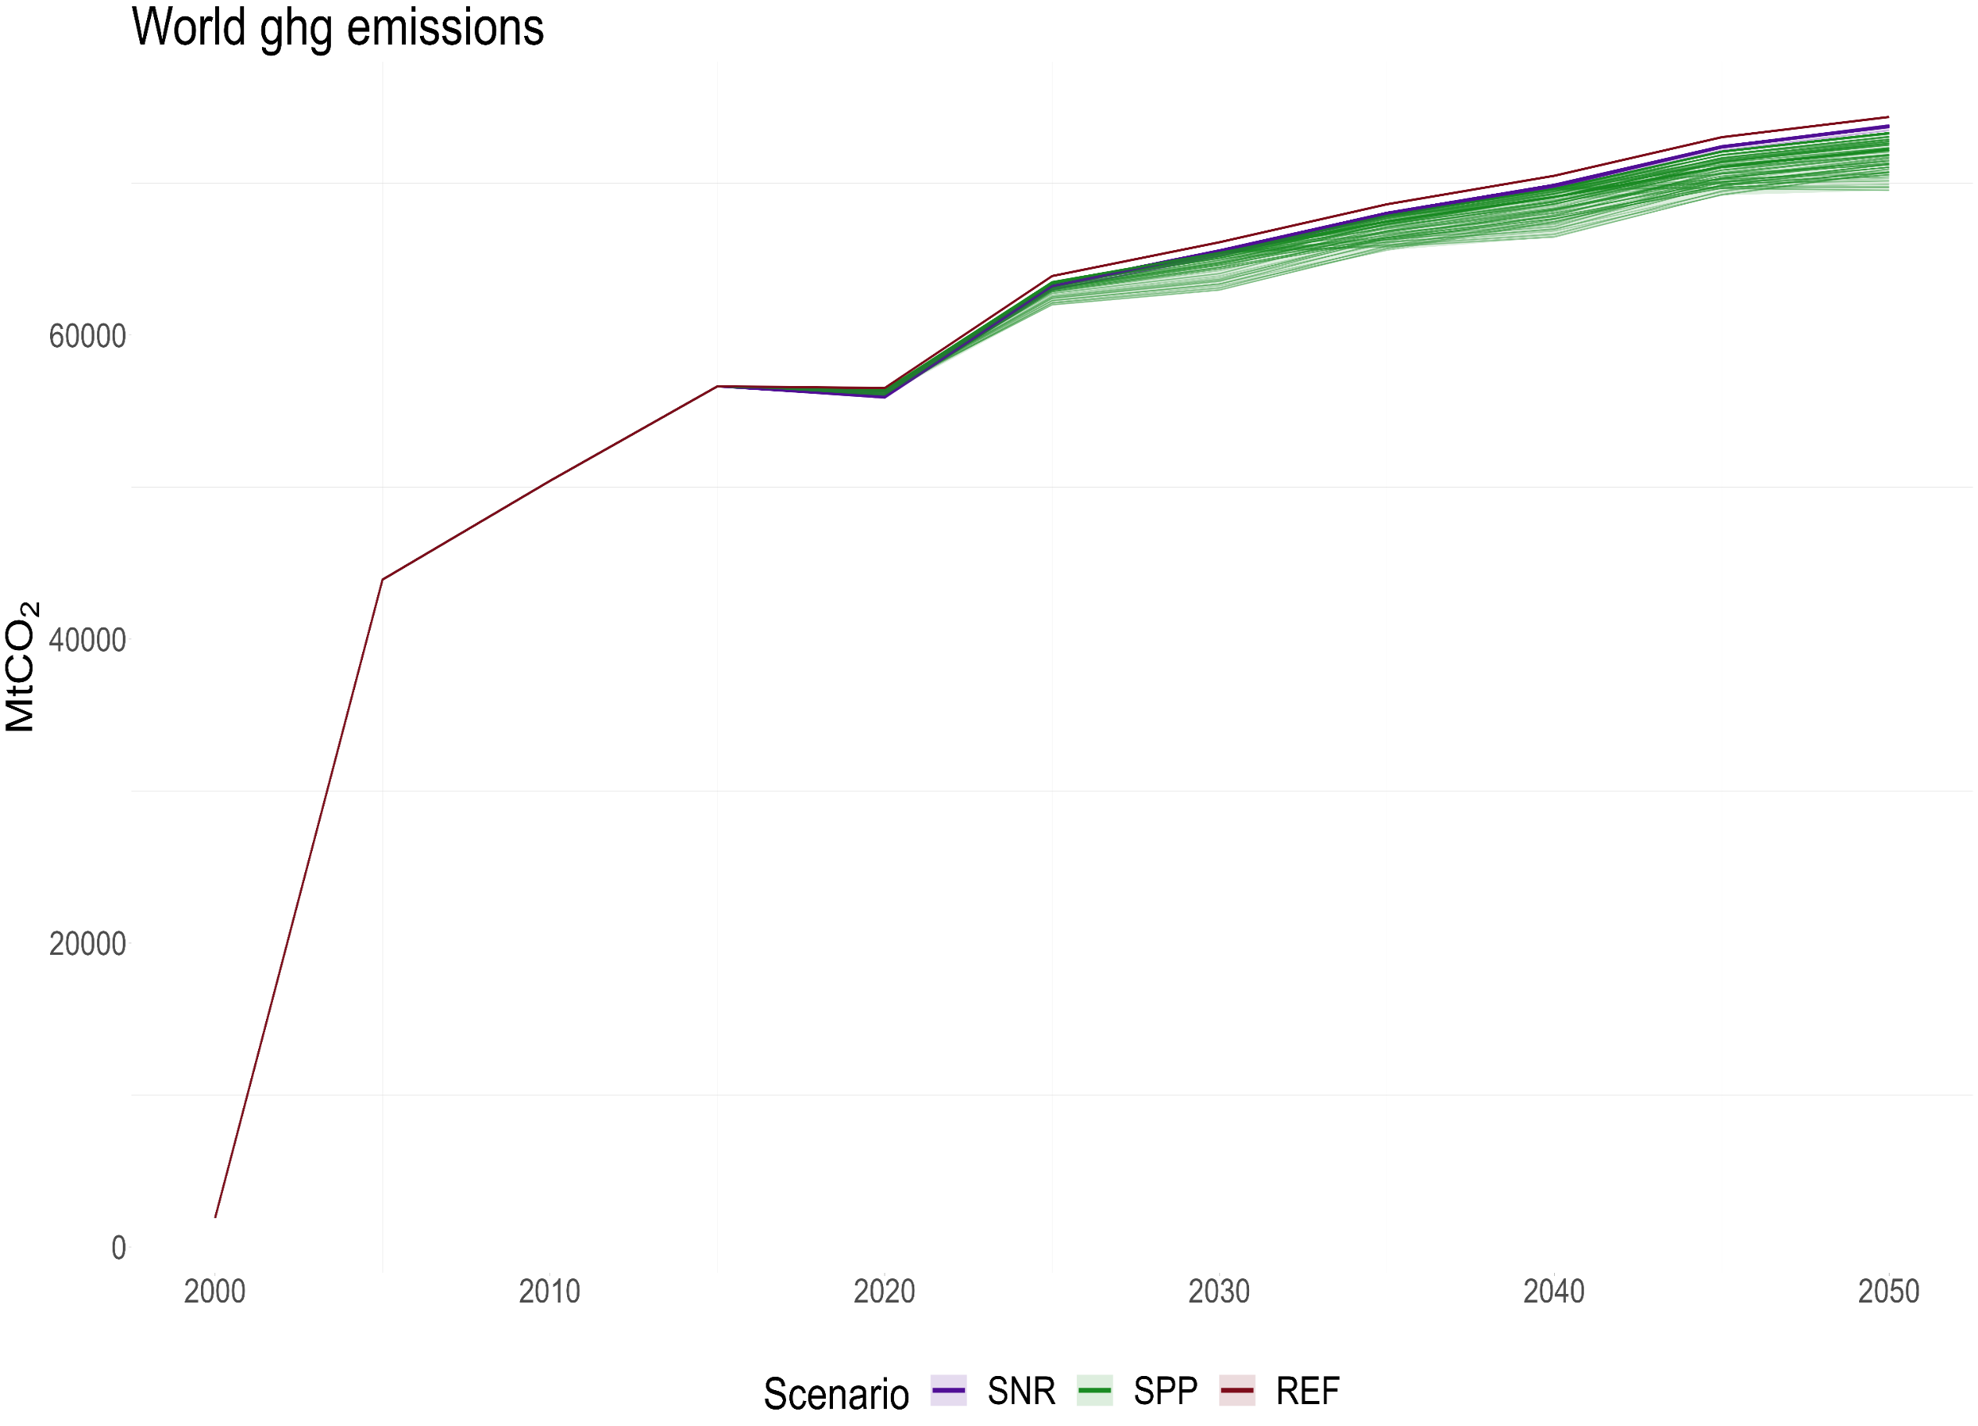
GHG emissions
GHG would be reduced, specially following the SPPs
Fig: ghg emissions

Slide 23
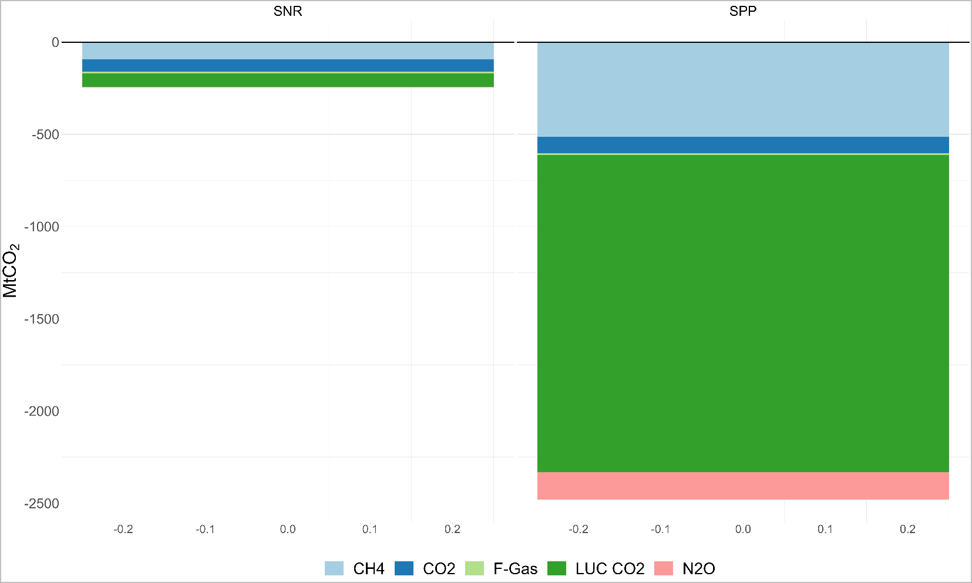
GHG emissions
GHG would be reduced, specially following the SPPs
SPP would drastically reduce the LUC CO2
Fig: ghg emissions

Slide 24
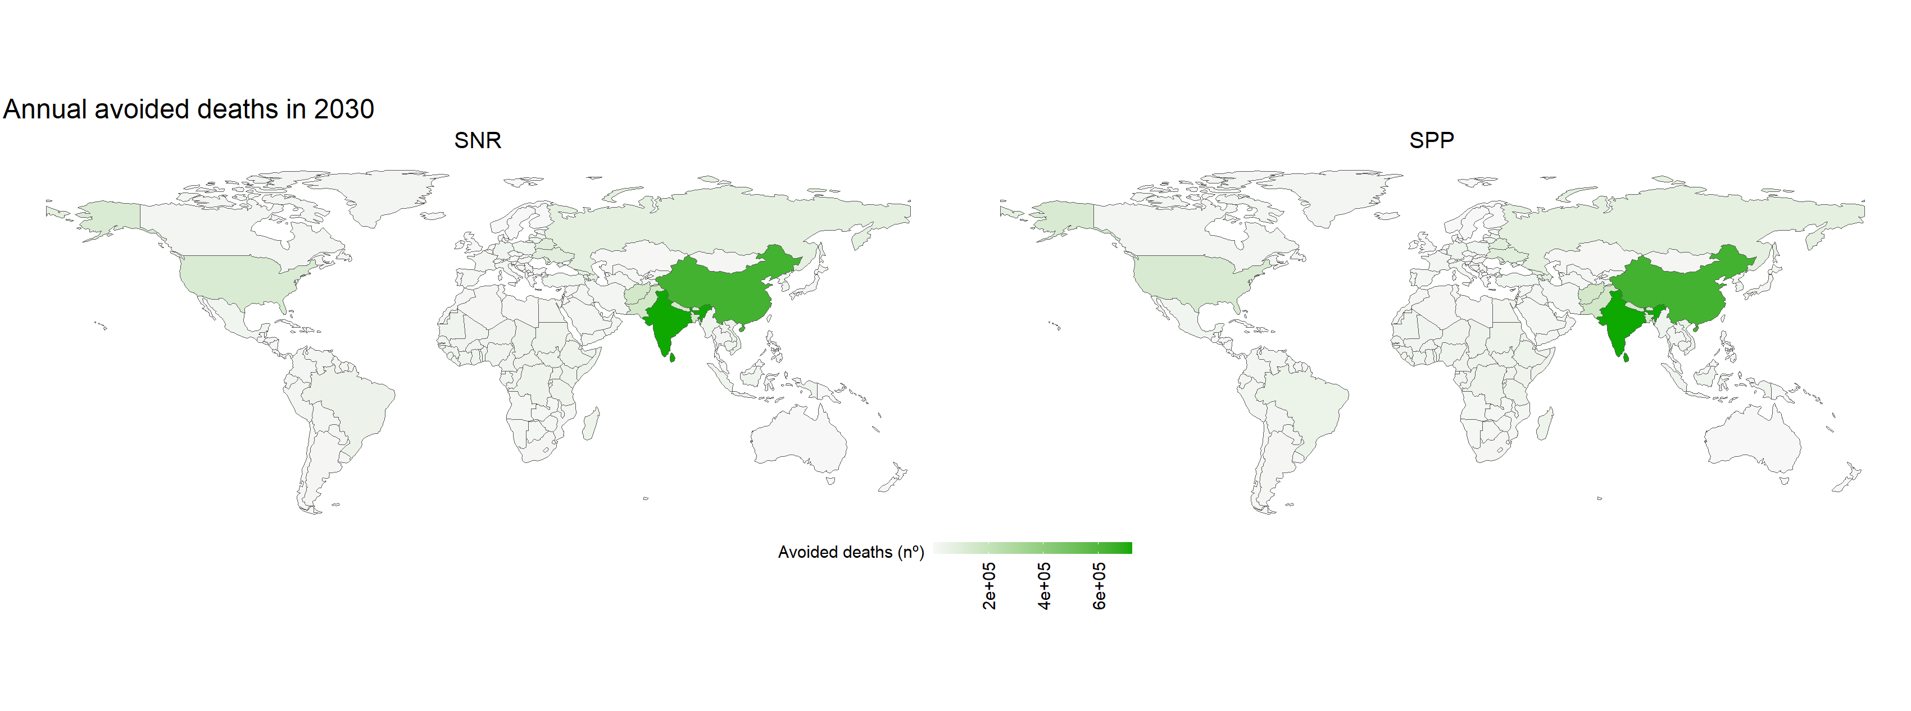
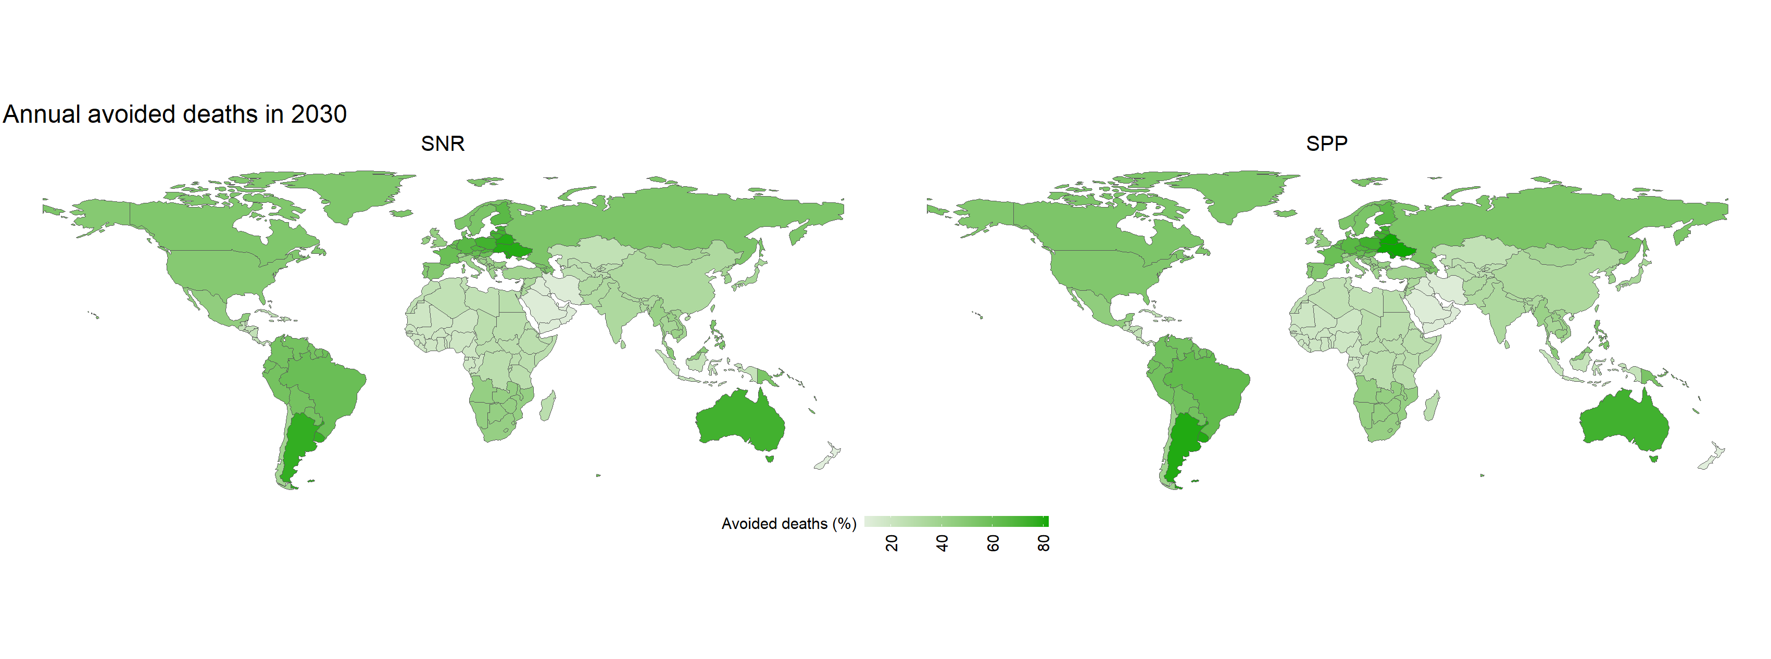
Air pollution health impact
Fig: avoided premature deaths due to AP
All regions will avoid premature deaths due to air pollution

Slide 25
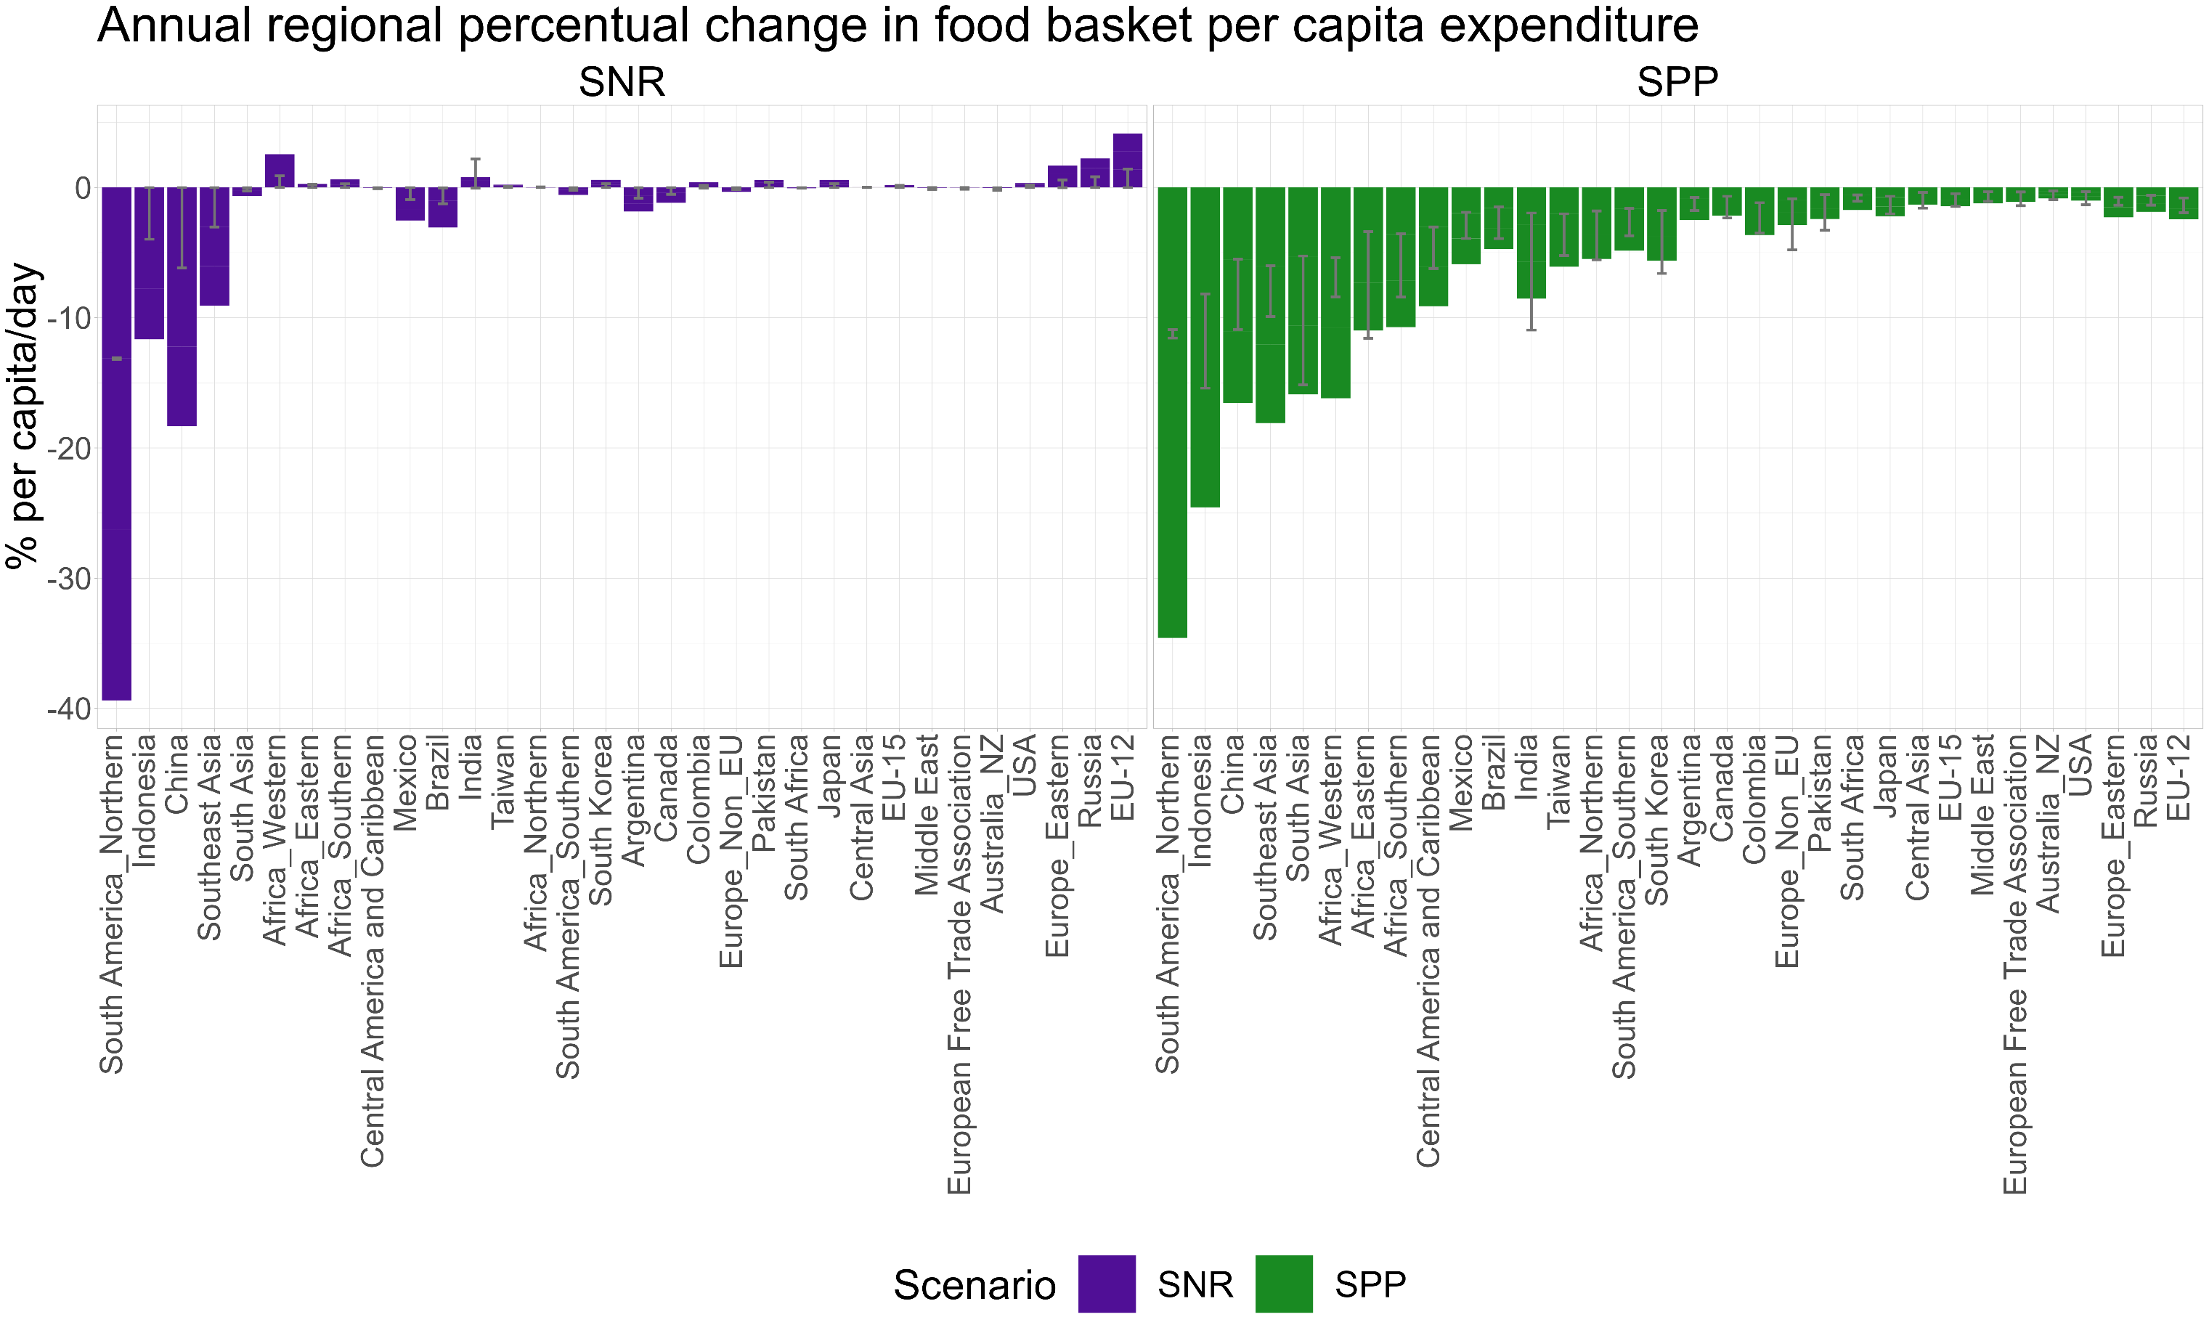
Per capita annual food expenditure
SPP would reduce the food expenditure everywhere
SNR would benefit specially South America Northern
Fig: food expenditure by capita daily

Slide 26
Next steps
Compute the mitigation cost of these scenarios
Consider only the scenarios that meet the minimum nutritional requirements in terms of Kcal, macronutrients & micronutrients intake
Run more scenarios to have a better overview of the possible more extreeme dynamics

Slide 27



Clàudia Rodés Bachs
claudia.rodes@bc3research.org
#iam-compact
iam_compact
iam-compact
iam_compact

